Slide 1

Big Data-driven Health Insurance Analysis!
BY- Navya Jammalamadaka
Rahul Rathod

Slide 2
PROBLEM STATEMENT AND DATASET OVERVIEW
To analyze the health insurance plans, present in the US and present a study about the insights retrieved. An unimaginable amount of people apply for different insurance plans every year, Similarly the cost of health insurance in the US is high.
It is important to understand the plans, the providers and coverage options so that we can know where the investment is going and avail an opportunity to utilize the plans carefully.
2021-2023
3.4 GB
Data from CMS
Data size

Slide 3





AGENDA AND MOTIVATION
PHASE 1
PHASE 3
PHASE 5
Collecting , cleaning the data
Building the insights with PySpark
Future Scope
Analysis on broader aspects (Geography, Features effecting plans etc.,)
Analyzing Data
PHASE 2
PHASE 4
Motivation:
An unimaginable amount of people take health insurance plans every year. The amount of data gathered and information available to process is immense, where in the processed data can have several use cases.
Decision Support for Insurance Applicants.
Transparency in decisions.
Action Items for CMS.

Slide 4
WHY IS THIS A BIGDATA PROBLEM?
Volume: Every year the scale of the data increases.
Value: Several stakeholders can benefit from drawing insights from this data.
Velocity: Every day there are huge number of applicants, hence generating large data rows at real time.
Veracity: The data is acquired The Centers for Medicare & Medicaid Services, CMS, which is part of the Department of Health and Human Services and hence can be trusted for truthfulness and accuracy.
Variety: Data deals with different data types and considering the computational time required for visualizing and acquiring useful information, we require big data technologies to draw any insights from it.

Slide 5
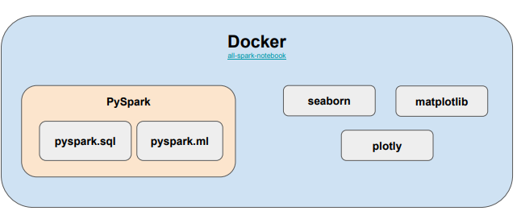
APPROACH AND ARCHITECTURE
Clean the data in the dataset, analyze it and provide a descriptive summary.
Draw visual insights from data geographically and timely.
Summarize the overall trend in insurance plans through the years 2021-2023.
Group the data by plan types and draw independent insights, to understand specific plan type information and factors effecting these plans.
Draw conclusions from the information acquired and perform required action items.

Slide 6
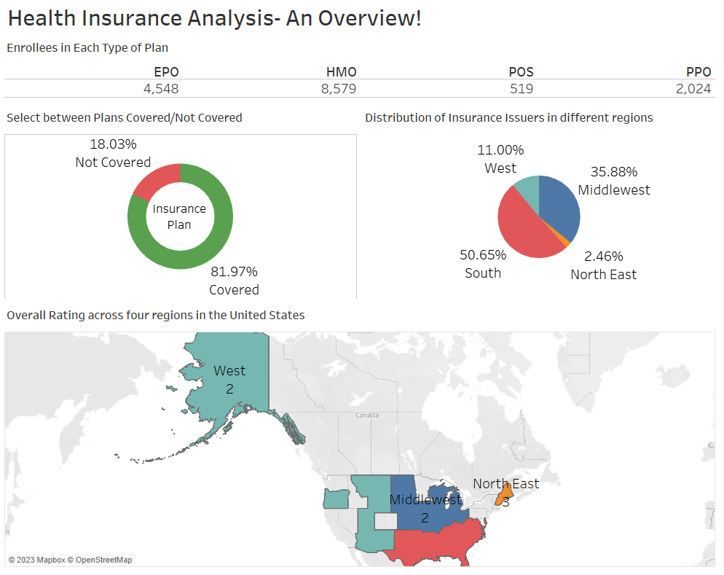
Overview of Data

Slide 7
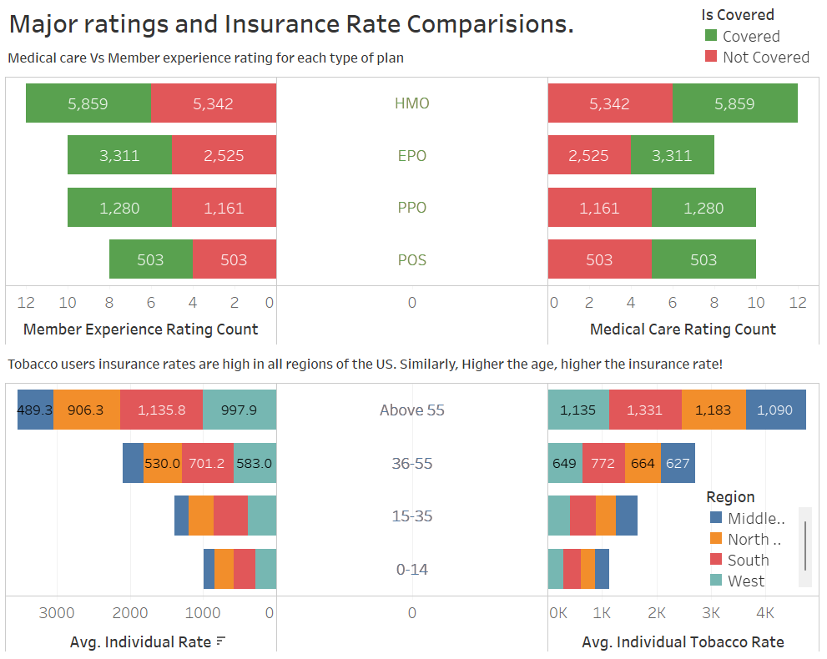
Major Comparisons

Slide 8
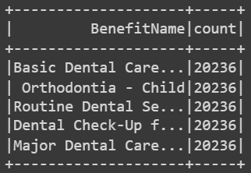
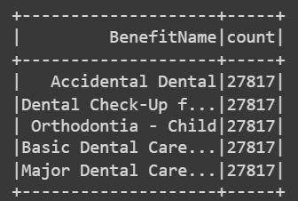
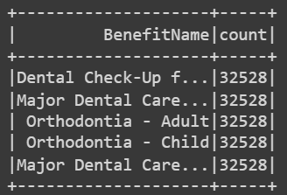
PART 1- Analysis of Plan Benefits
Top 5 benefits in each of the years 2021, 2022, 2023 -
2021
2022
2023
Conclusions:
● For most of the states, the maximum used benefit is dental care/Orthodontia.
● Thus, dental care is the most sought-after benefit.
● Insurance providers can use this info and design their plans accordingly.

Slide 9
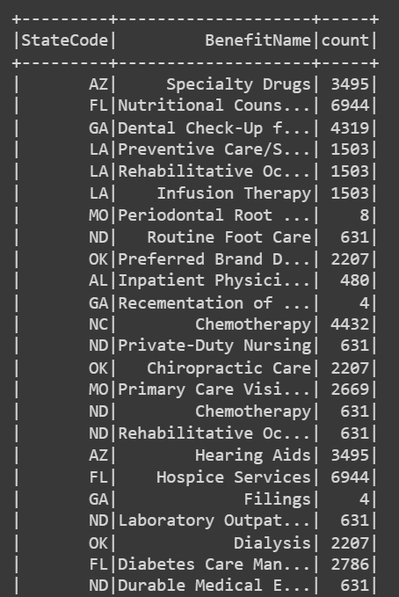
PART 1- Most availed Plan Benefit per State
● Find distinct states and Preprocess state codes to remove junk values.
● Group by state code, benefit name and find the benefit counts.
● Use the window function to find the top benefit used in each state.
● We can get an idea of which healthcare service is most needed in each state from this table.

Slide 10
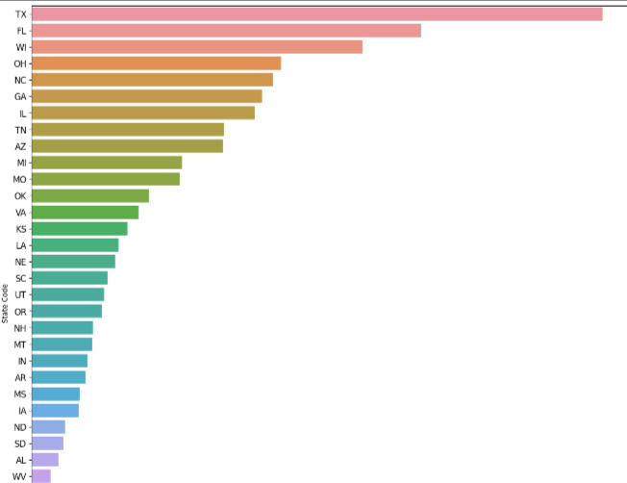
PART 1- Plan Benefits Across States
Texas, Florida, Wichita, Ohio and North Carolina are the top five states that have the most plan benefits during the years 2021-2023.
~742k
~324k
Ohio
Texas
~506k
~313k
North Carolina
Florida
~430k
Wichita

Slide 11
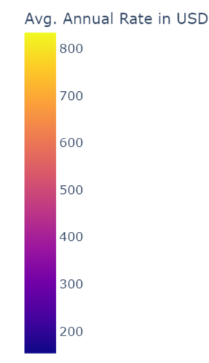
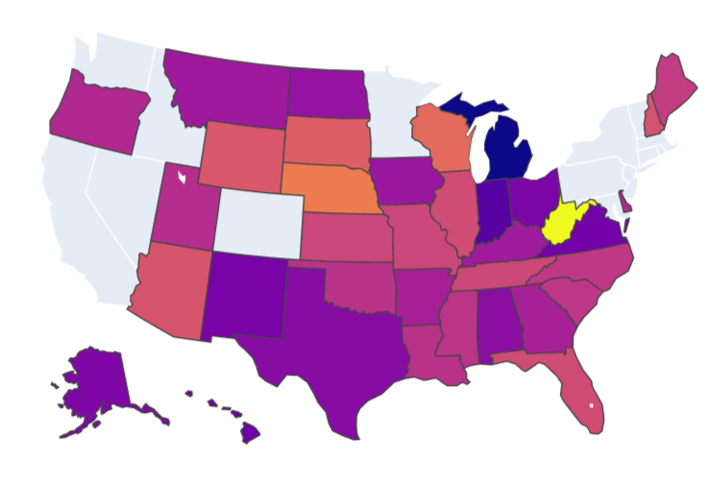
PART 2- Rate Vs State Analysis
A user or an insurance company may want to know how the overall rates for an insurance plan varies across states. Why?
● Informs user whether living in a particular state has an effect on cost of their insurance plan.
● The insights obtained can help insurance companies structure new insurance plans.
Conclusion - There is no clear dependence between an individual's insurance plan rate and the state that the individual is from (there was a low correlation ratio= 0.044)

Slide 12
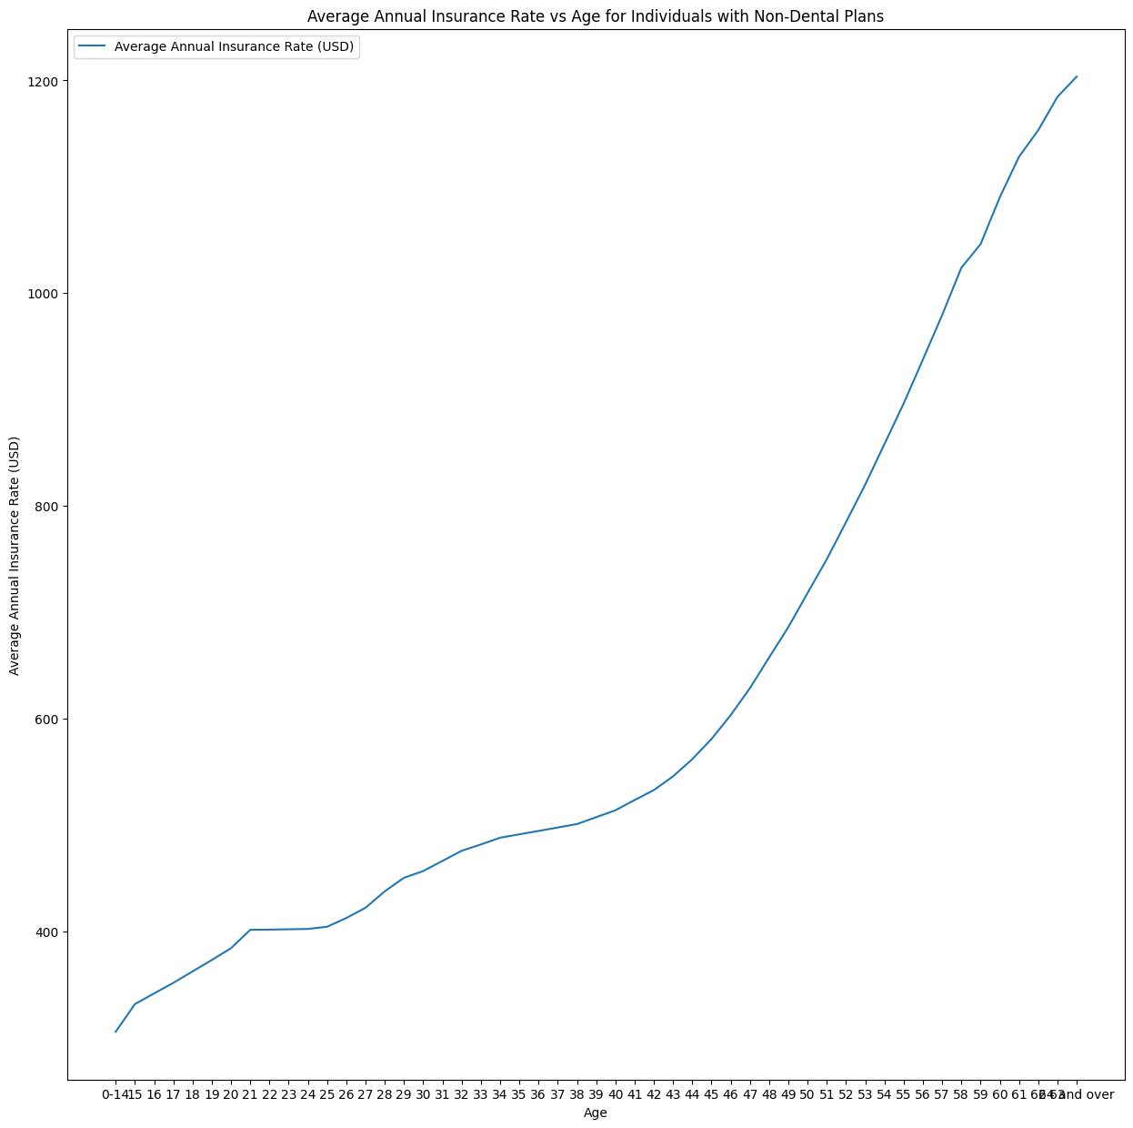
Part III - Effect of Age on Plan rates
● Comparing the average plan rate with age for non-dental plan, the average increases with age.
● Correlation is - 0.7599
Conclusion:
Plan rate increases with age
Age and Plan rates are strongly dependent.
Insurance users can keep this in mind while setting aside money for an insurance plan

Slide 13
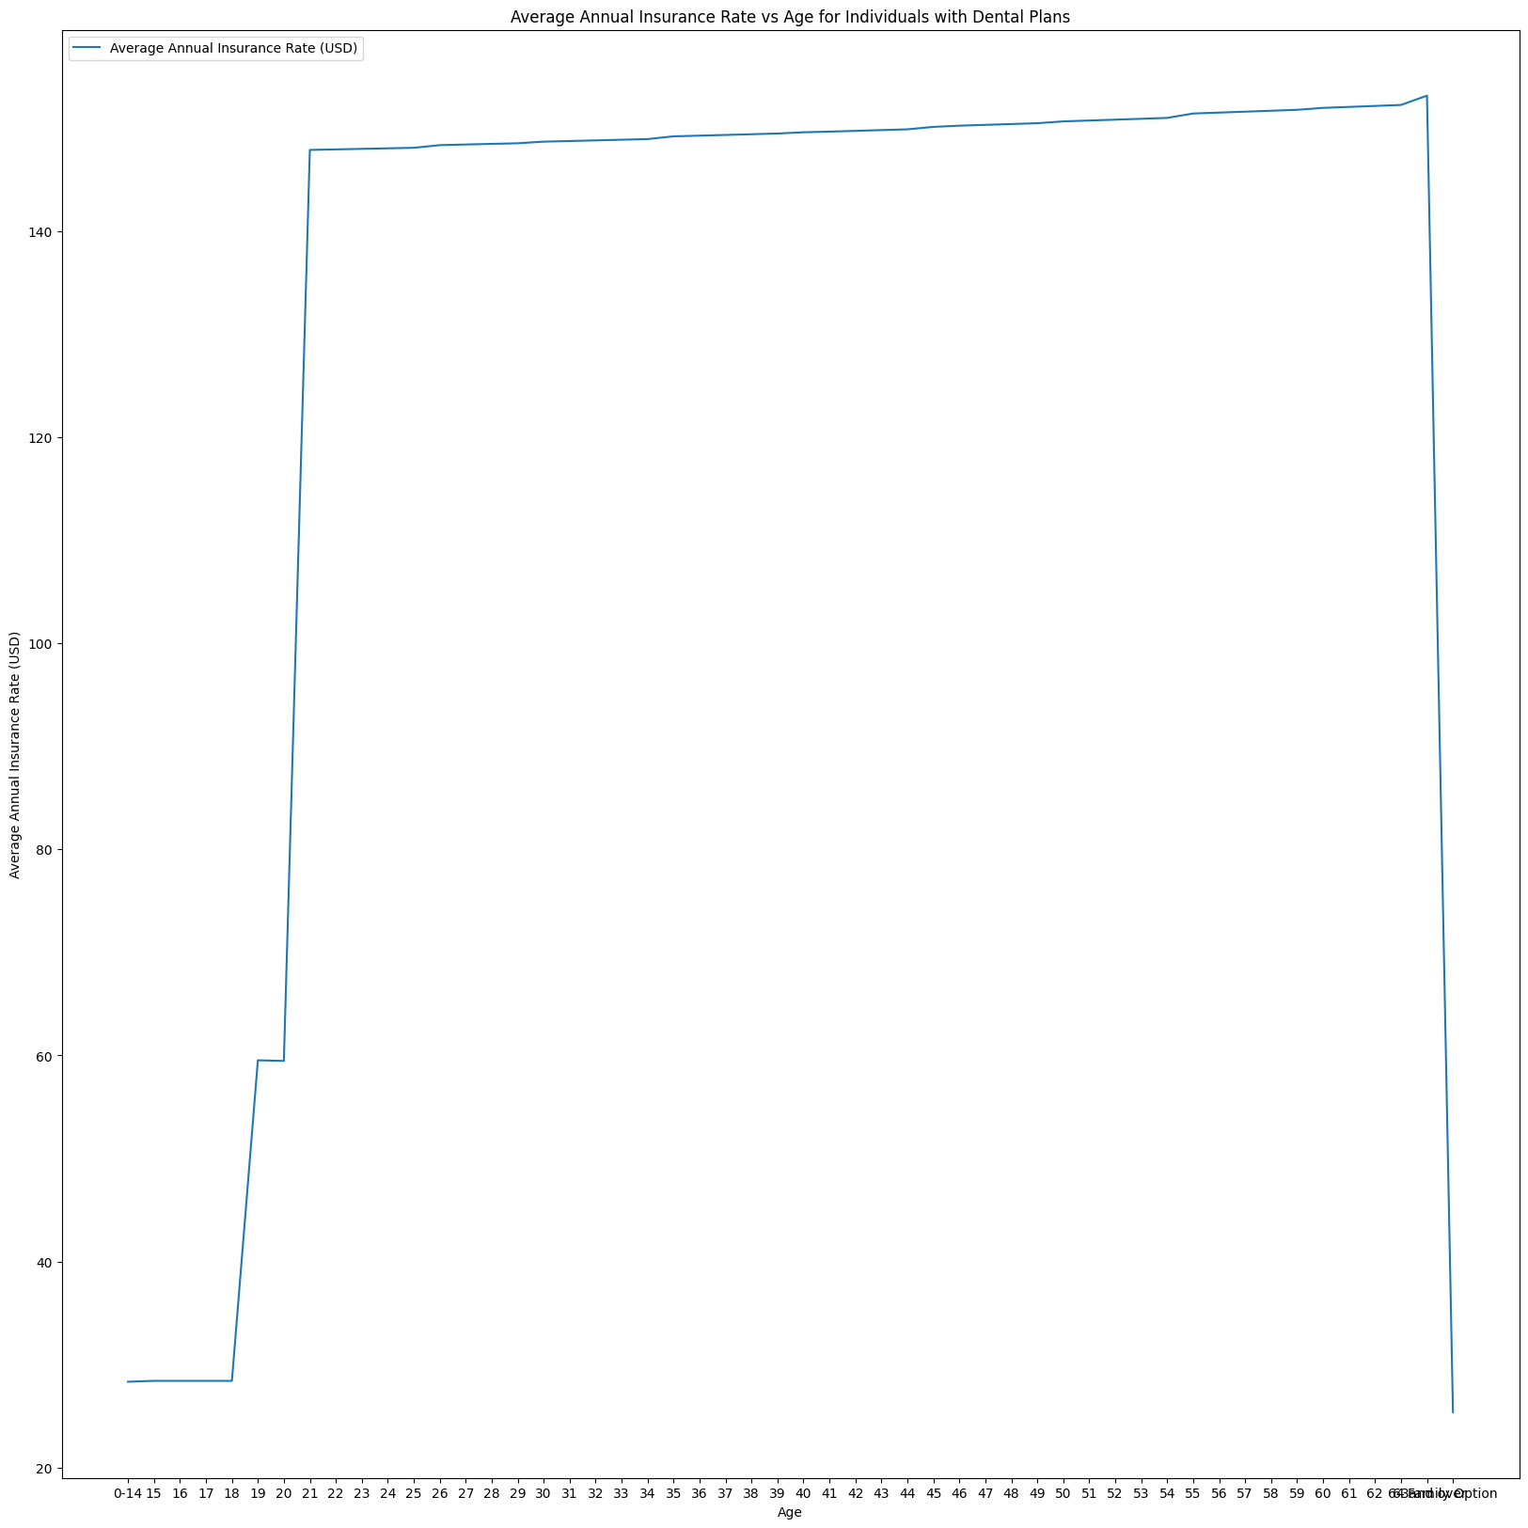
Part III - Effect of Age on Plan rates
● Comparing the average plan rate with age for dental plan, the average increases with age.
● Correlation is - 0.025
Conclusion:
Age and Dental Plan rates don’t seem to be dependent.
Also, the dental insurance plan rates are relatively higher. Thus, dental insurance is sought after, irrespective of the age.

Slide 14
Part III- Effect of Health Habits on Plan Rates
● Some plan users have tobacco preferences, and some have no preference.
● Considering the Individual Tobacco Rate for users with tobacco preference, the correlation between Individual Tobacco Rate and Plan Rates is 0.9914 with the plan rates increasing as tobacco rates increase.
Conclusion:
Insurance providers could look to make more affordable plans for Tobacco users

Slide 15
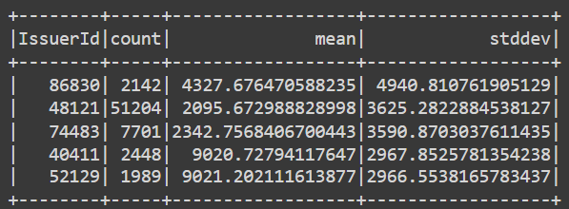
Part IV - Distribution of Rates across Issuers
● Analyzing how the individual rates are distributed across each of the issuers tells us how diverse an issuers portfolio is.
● Calculating the mean, standard deviation and the count of individual rates for each issuer can tell us how the rate is distributed among these issuers.
Conclusion:
Displayed the final issuers which have the highest standard deviation since they have the most diverse portfolio

Slide 16
Part V - Predicting Individual Insurance Rate
● Create a linear regression model to predict individual Rate
● Features (predictor variables) - Age, Individual Tobacco rate
● Criterion variable - Individual Insurance Rate
● PySpark ML features - Vector Assembler, Pipeline
● Train, test split of 70-30
● R2 value - 0.98 Accuracy - 98.235

Slide 17
TAKEAWAYS FOR FUTURE
The following recommendations can be implemented in order to contribute towards more Health Insurance Analysis.
First Recommendation
Analyze correlation between other variables to determine the best features to use to predict insurance rates more reliably.
Second Recommendation
Use new features to build a recommendation system for the user.

